Slide 1
LNHS PTSA Wednesday, April 26, 2023 6:30pm General Meeting & Annual Board Elections
Followed By
Senior Scholarships and Presidential Service Awards

Slide 2
LNHS PTSA Meeting Agenda April 26, 2023
Agenda:
Welcome/Confirm Quorum/FB Live Attendees
Meeting Called to Order by President
Introductions/Special Guests
Position Board Members
President Christal Feldman
1st VP - Membership Brenda Meadows
Treasurer Michelle Adamick
Recording Secretary Gabriella Nguyen
Corresponding Secretary Sophia Rogers
Chairs
LWL Advisors Suzanne Arnold/Tania Abreu
Finance Gita Raghoonandan
Staff Appreciation Angie Garcia/Hannah Howell
Legacy Bricks Dierdre Smith/Kristie Zappas
Web Master Erika Remley
Staff Liaison Kari Grimm
OLD BUSINESS
Approval of Past Minutes (February)
Review of March Financial Report
NEW BUSINESS
Membership Updates
Spirit Wear Sales
Student Design Contest
Legacy Brick Campaign - Deadline 5/1
Staff Appreciation
Volunteer Appreciation Month
Learn with Lions
Board Elections
Senior Scholarships
Presidential Service Awards
Communication Updates/Announcements
Next General Meeting - Tuesday, 5/16 at 6:30pm
Meeting Adjourned by President
Congratulations to our Senior Scholarship and Presidential Service Award Recipients!

Slide 3
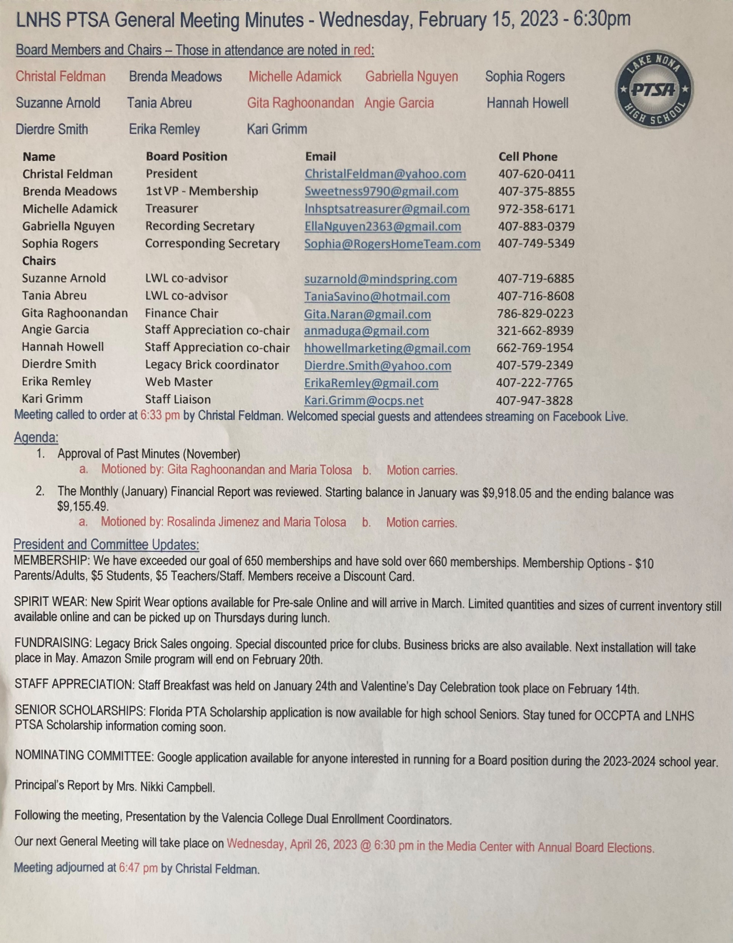
PAST MINUTES FOR APPROVAL February 15, 2023

Slide 4
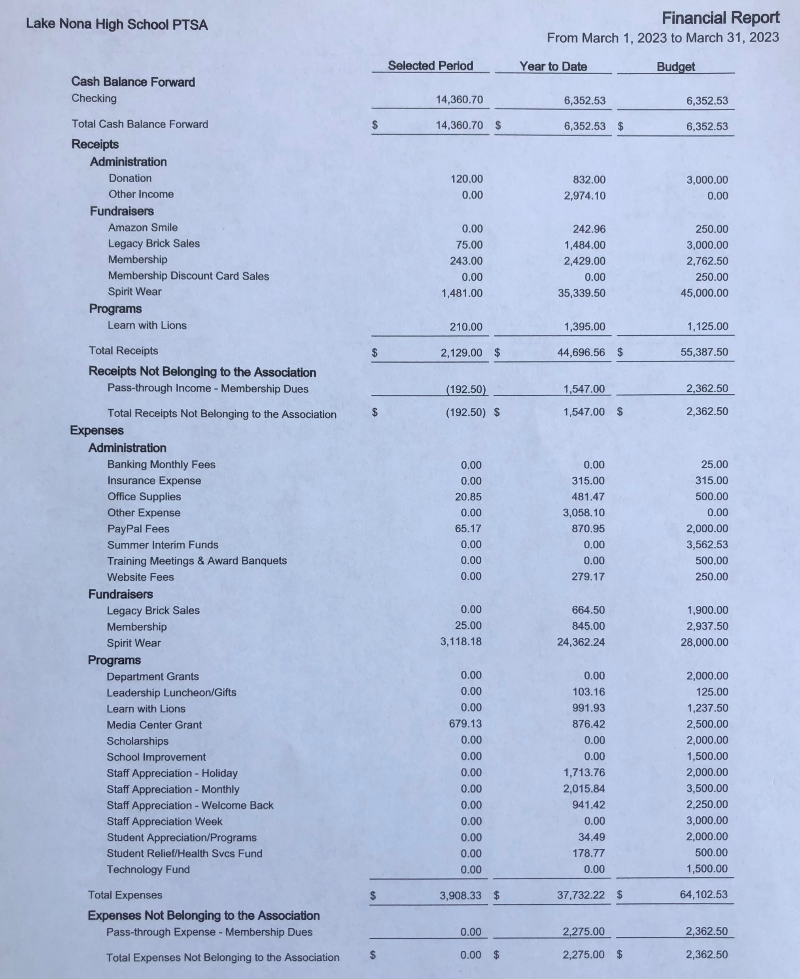
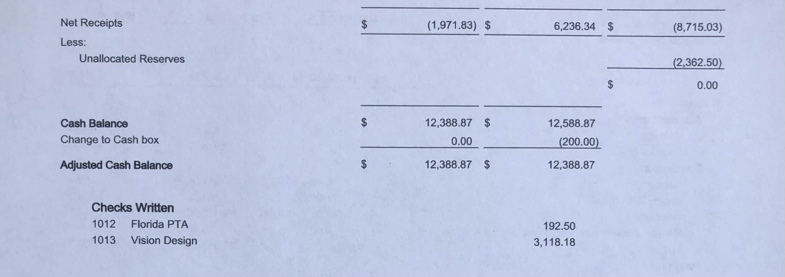
FINANCIAL REPORT FOR APPROVAL March 2023 Financial Report
Year to Date Summary March Beginning Balance - $14,360.70
March Ending Balance - $12,388.87

Slide 5
PTSA MEMBERSHIP - Currently Over 735 Memberships Received - Our Goal was 650 Memberships OVER 75 Teachers & Staff OVER 280 Students OVER 25 Community Members OVER 30% INCREASE FROM LAST YEAR Membership Options Parent/Adult - $10 Teachers & Staff - $5 Students - $5 (Includes Discount Card)

Slide 6
SPIRIT WEAR - Limited Quantities and Sizes Available (Youth up to 3XL) - Spirit Store On Campus (Thursdays During Lunch)

Slide 7
STUDENT DESIGN CONTEST Deadline
Friday, May 5th

Slide 8
LEGACY
BRICK SALES - Great Gift for Seniors & Alumni
- Special Pricing for Clubs
Business Bricks Available
Deadline EXTENDED until Monday, May 1st

Slide 9
STAFF
APPRECIATION
May 8 - 12, 2023
Grab & Go Lunch
May 9th
APRIL
Mailbox Gift

Slide 10
THANK YOU VOLUNTEERS!

Slide 12
LWL Spring 2023 Recap
Our PTSA LWL Club has top performing high school students tutor elementary & middle school students in reading or math. These free private online tutoring sessions are 1-2 times per week, and the tutors earn community service hours.
Spring 2023
Our 2023 LWL board started up in January with 17 high school students including 6 sophomores, 6 juniors, and 5 senior advisors
We had 58 high school tutors help over 65 elementary & middle school students in reading & math.
We logged over 914 volunteer hours!
Summer & Fall 2023
Our current members can tutor this summer, but no new tutors.
We are currently prepping for fall 2023 by revising our ads, applications, forms & training program.
Program Advisor: Mrs. Abreu

Slide 13
VOLUNTEERING
Needed: 2nd Parent ADVISOR
Learn With Lions is our PTSA student club. Top performing high school students can join the club to earn Community Service Hours by doing private one-on-one virtual tutoring for elementary and middle school students in the Lake Nona area.
Our club has been very successful, but we need a 2nd parent (or a team of 2 parents) to help run the club.
The club is completely virtual / online through Zoom or Webex
Hours – Weekly Virtual Club Meetings on Wed at 5pm during the school year
(plus some additional small meetings & time planning etc.)
Everything done in Google Drive (forms, spreadsheets etc.)
Work with student board to follow up on their responsibilities
2 advisors make it twice as easy to run and split up duties
COMMIT – BUT DON’T OVERCOMMIT!
Please email Advisor-LWL@LNHSPTSA.com if you are interested or have questions. Thanks!
www.LearnWithLions.com

Slide 14
History of the PTSA Learn With Lions Club

Slide 15
What Makes our Club Special:
Tutor Fall or Spring or both
Option for Summer
You select days & times
Flexible options to reschedule
Earn volunteer hours every week
Tutor virtually from home
No meetings at school
Student Board is made up of Sophomores & Juniors
Only Club run by a PTSA

Slide 16
ANNUAL BOARD ELECTIONS Cristen Krugh Nominating Committee Chair
Thank You to our Nominating Committee Members
for interviewing a record number of candidates!
Nominating Committee Members
Cristen Krugh - Committee Chair Dana Dutch, Rosalinda Jimenez, Ishu Martinez and Ivory Rodante
These committee members have recommended
the following slate of officers for the 2023-2024 school year…
President - Dana Dutch
Vice President - Carrie Palumbo
Treasurer - OPEN
Corresponding Secretary - Gloria O’Neal
Recording Secretary - Juhi Shah
(Student Position)

Slide 18
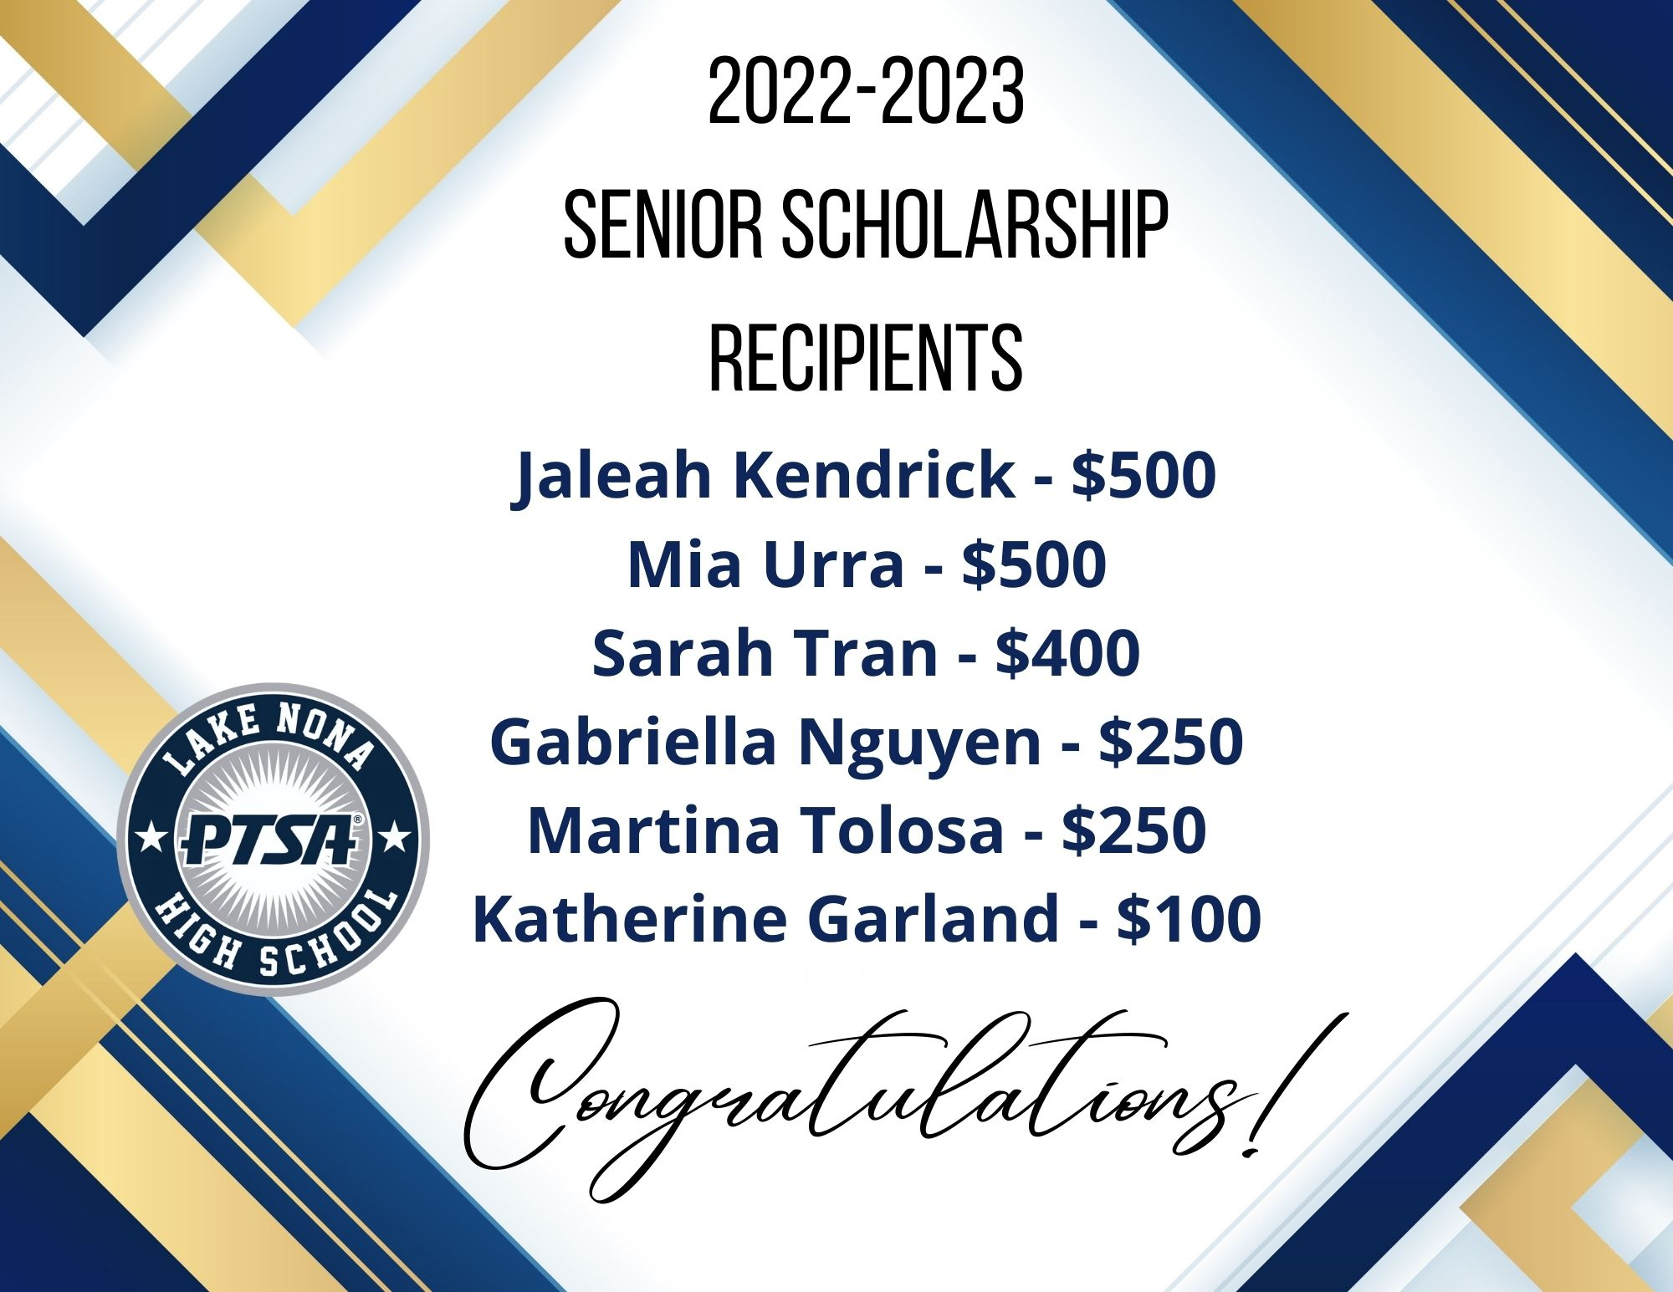
THANK YOU TO OUR SCHOLARSHIP COMMITTEE

Slide 19
Thank You, Stuart and Patti Gutter!
407-774-8412
www.AmericanBalloonDecor.com

Slide 20
SENIOR CORDS
Alexis Gruber
Howard Miller
Jaleah Kendrick
Kaira Medina-Cotto
Mia Urra
Natalie Guido
Saida Sadikova
Sarah Tran
Timothy Macias
Valeria Palacios

Slide 21
Criteria By Age Group
Hours in 12 months (Mid-March)

Slide 22
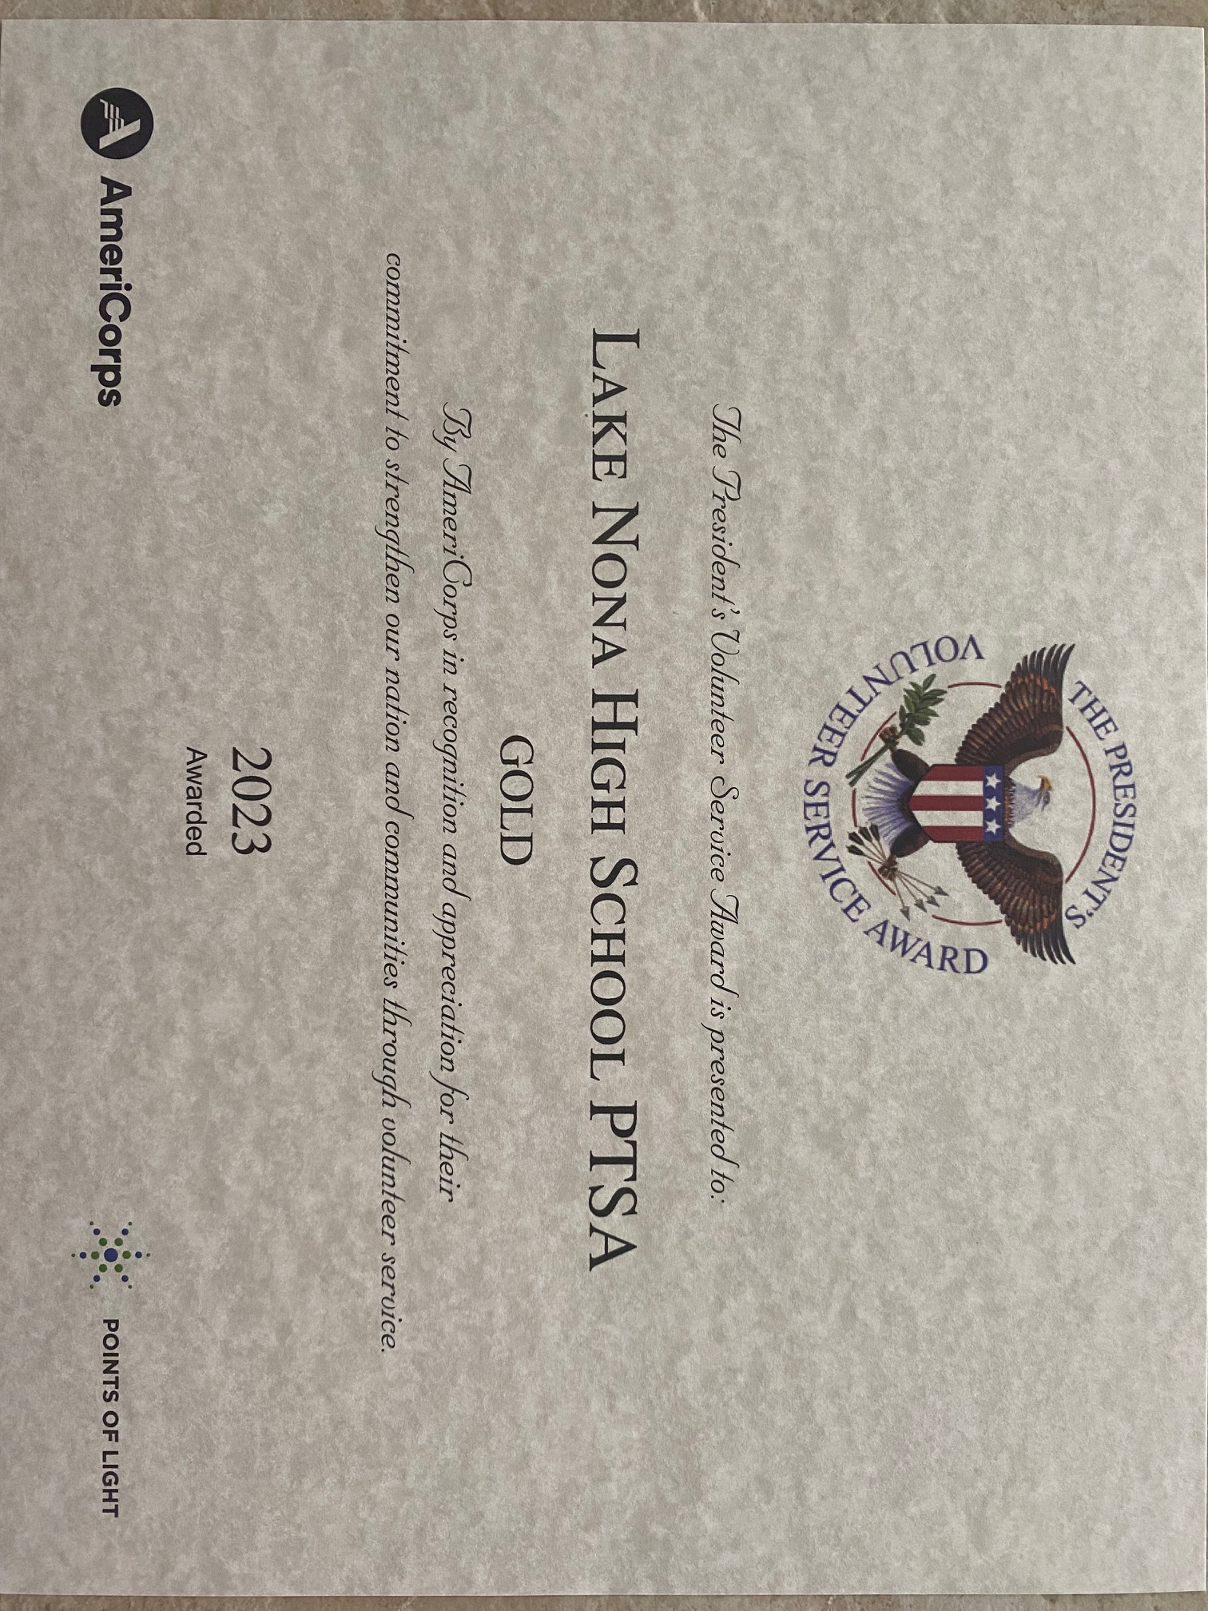
LNHS PTSA
Volunteers
(with over 25 hours each)
Gold Level
Group Award
Angie Garcia
Gabriella Nguyen
Gita Raghoonandan
Sophia Rogers
Suzanne Arnold
Tania Abreu
(The total hours for this
12-month period was 506.)

Slide 23
LNHS PTSA
Individual Awards
Gold Level
Christal Feldman
760 Hours
Michelle Adamick
505 Hours
Silver Level
Brenda Meadow
360 Hours

Slide 24
50 - 75 hours
Mia Urra
Sarah Tran
Abigail Itty
Valeria Palacios
Timothy Macias
Alaina Lauer
25 - 49 hours
Bethany Dang
Blair Buckner
Chisom Henry-Okereke
Daniyl Nguyen
Felipe Itinoche
Gabrielle Abriam
Howard (Marcus) Miller
Jaleah Kendrick
Kaira Medina-Cotto
Karol Belen
Kate Satterfield
Krit Dass
Marcus Abreu
Natalie Guido
Safi Ali
Saida Sadikova
Shreya Sreekanth
Shruti Sreekanth
Thitema Luanglatbandith
LWL Club had 25 tutors each with over 25 hours qualifying for the Gold Level Group Award.
Total hours for this 12-month period was 706!

Slide 25
Learn With Lions
Individual Awards
Gold Level
Alaina Lauer
135 Hours
Krish Kapoor
103 Hours
Krit Dass
100 Hours
Silver Level
Thitema Luanglatbandith
77 Hours
Hours based on total Community Service Hours
or 12-month period ending Mid-March

Slide 26
Lake Nona Regional Chamber Education Committee Awards
New Award for LWL Tutors
Based on Total Cumulative Hours for the Club

Slide 27
Gold:
Shreya Sreekanth
Mia Urra
Shruti Sreekanth
Kaira Medina-Cotto
Jaleah Kendrick
Timothy Macias
Natalie Guido
Safi Ali
SILVER:
Sarah Tran
Valeria Palacios
Gabrielle Abriam
Alaina Lauer
Daniyl Nguyen
Abigail Itty
Bronze:
Howard (Marcus) Miller
Fernanda Goncalves
Souha Hani
Saida Sadikova
Thitema Luanglatbandith
Felipe Itinoche
Devona Henry

Slide 28
Daniyl Nguyen | 11 | President - Procedures
Krit Dass | 10 | VP Operations
Shreya Sreekanth | 11 | VP Logistics
Shruti Sreekanth | 11 | VP Scheduling
Thitema Luanglatbandith | 10 | VP Tutor Communications
Alaina Lauer | 10 | VP Tutor Development
Abigail Itty | 11 | President - Programs
Chisom Henry-Okereke | 10 | Secretary & Historian
Karol Belen | 10 | Treasurer
Safi Ali | 11 | Director of Recuitment
Bethany Dang | 10 | VP Marketing
Marcus Abreu | 11 | Webmaster & Content Manager
Senior Advisors: Jaleah Kendrick, Kaira Medina-Coto, Mia Urra,
Natalie Guido, Sarah Tran

Slide 30
PTSA STAFF APPRECIATION

Slide 31
STAY CONNECTED
WITH LNHS PTSA
www.LNHSPTSA.com
www.Facebook.com/LNHSPTSA
SAVE THE DATE
Next General Meeting
May 16th at 6:30pm
(Tuesday)

